Slide 1

Packing machines and its mechanism
-By
Galla Lahari, Ayush Choudhary, Pradeep Kumar

Slide 2

Introduction
PACKAGING MACHINES are the machines that
complete stages of packaging process. Examples include filling machines, sealing machines, wrapping machines, strapping machines, labelling machines and coding machines.

Slide 3
Overview
Types of packaging machines
Kinematic mechanism of packaging machines
Mathematical Modelling for liquid packaging
Function
Video on industrial packing machines
A sample model of packing machine
References

Slide 4
Types
Based on degree of automation
Automatic packaging machine
Semi automatic packaging machine
Based on types of processed products
Liquids
Solids, including powders
Based on types of packaging products
Filling machines
Sealing machines
Wrapping machines
Strapping machines

Slide 5


Slide 6
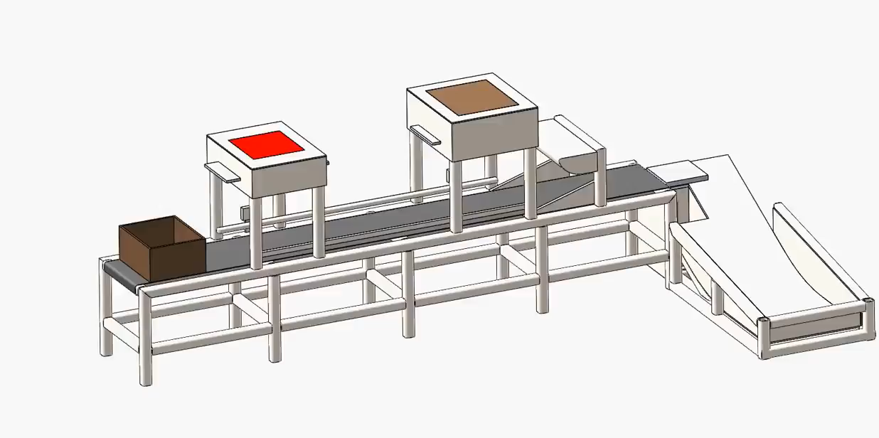

Slide 7
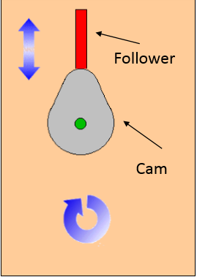
Liquid Packaging Machine
For liquid packaging, Cam and follower is used.
Specifications of Cam and Follower:
Motion: Double Harmonic Motion with single dwell
Type: Rotating Cam –Translating Follower
Cam Type: Pear
Follower Type: Flat Foot
Radial Cam and Radial Follower

Slide 8
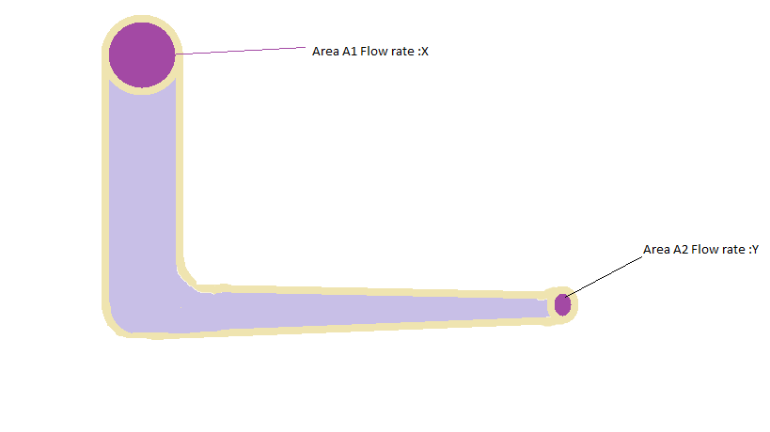
Mathematical Modelling
Machine designed with following specification as shown in figure:
Inflow rate of fluid: X Lt/sec
Inflow gate Area: A1
Outflow gate Area :A2
Outflow rate of fluid : Y Lt/sec
Assumption : At t=0sec, pipeline is
filled up with product
From , Equation of continuity of fluid,
A1X =A2Y
Y= (A1/A2)*X

Slide 9
Thus , for a given area A1&A2 with inflow rate X, we have outflow rate as Y. For example, our machine is filling product of 1Lt capacity, with Y known we can find time for filling of the product into the Container(Bottle). Time for filling ,T= Volume /Flow Rate= (1/Y)sec Let further assume, machine takes 0.5sec to seal the final product. So , total time is (T+0.5)sec. With Double harmonic motion with single dwell, we can make a model with following specification for follower : Rise(Outstroke)= 25cm Fall (Downstroke)= 25cm Dwell Time = (T+0.5)sec Angular velocity of cam= W rad /sec For cam motion, with rotation reference We can find degree of rotation of CAM for dwell period : ᶿ (change in angle) = W*(T+0.5)*180/3.14 Further, for single dwell with double harmonic motion, duration for rise and fall are same , so change in angle for Rise and Fall are : m =(360 - ᶿ )/2. Thus, final cam profile model is developed as For ᶿ = 0- m Rise of follower ᶿ = m -2m Fall of follower ᶿ = 2m- 360 Dwell period (Packaging period)

Slide 10
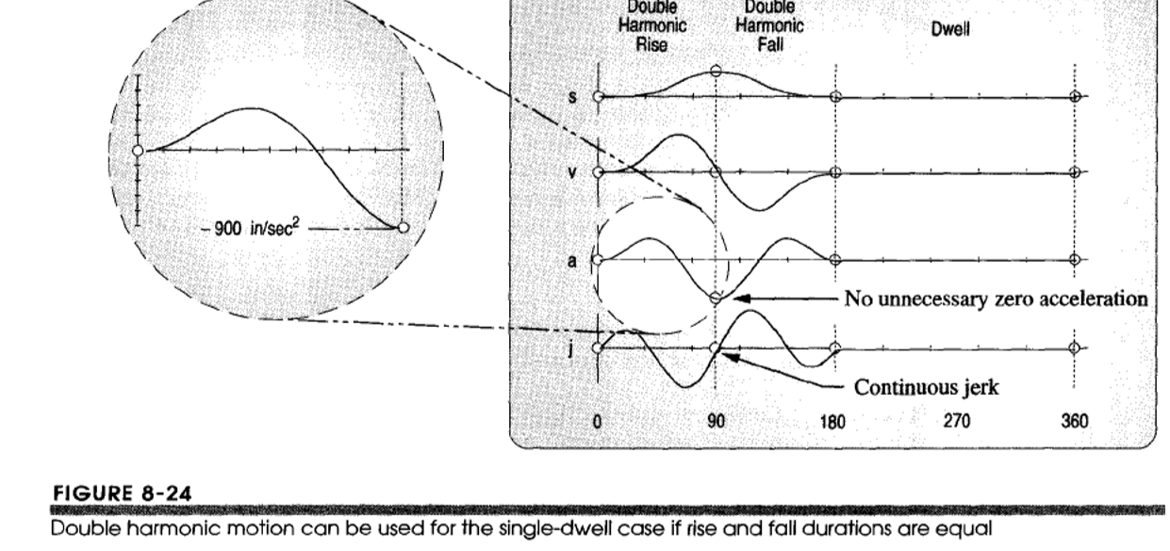
The period of rise and fall is used for channelizing the empty container to the spot for filling via conveyor belt. With increase in angular velocity and inflow rate, we can control and focus most of our model time in dwell period for packaging and increase the number of product packed per minutes.

Slide 11
The product passes through the conveyor belt to the inspection section where again with help of weighing machines , weight could be checked and quality check of finished product is done. Rejected pieces can be separated out manually. Thus defect free packaging is done.

Slide 12
Functions
Improve labour productivity . Sliding blister machine packaging machinery is much faster than manual packaging
Ensure packaging quality . Mechanical packaging is particularly important for exporting goods to achieve consistent packaging.
Handle specialized requirements, such as vacuum packaging, inflatable packaging, skin packaging and pressure filling.
Reduce labour and improve working conditions for heavy products
Protect workers from health effects brought by dust , toxic products and prevent environmental contamination
Reduce packaging costs and save storage costs for loose products such as cotton, tobacco, silk.

Slide 13
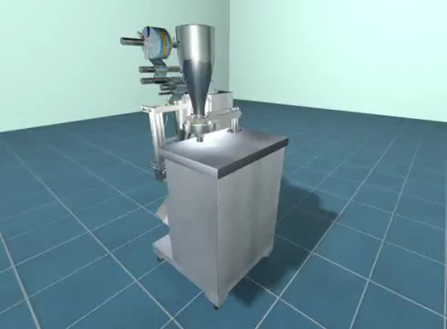
Industrial Packaging Machine

Slide 14
References for data
Introduction
https://en.wikipedia.org/wiki/Seal_(mechanical)
Types and description
https://en.wikipedia.org/wiki/Packaging_machine
Mathematical Modelling
Theory of Machines and Mechanisms by UICKER PENNOCK SHIGLEY (3rd Edition)
Packaging Machines
https://www.samaengineering.com
Videos used in presentation
https://www.youtube.com/watch?v=iVzj3VV91B8
https://www.youtube.com/watch?v=mpWx3KGijmk&t=61s
https://www.samaengineering.com/watch?v=iLas4QQ12D4

Slide 15
Thank You Ayush Choudhary 160103012 Pradeep Kumar 160103080 Galla Lahari 160103030

